Slide 1
Icon Imagery
What does your icon say about you?
This has a review of last week’s powerpoint (in case you could not see it), and the new project for this week.

Slide 2
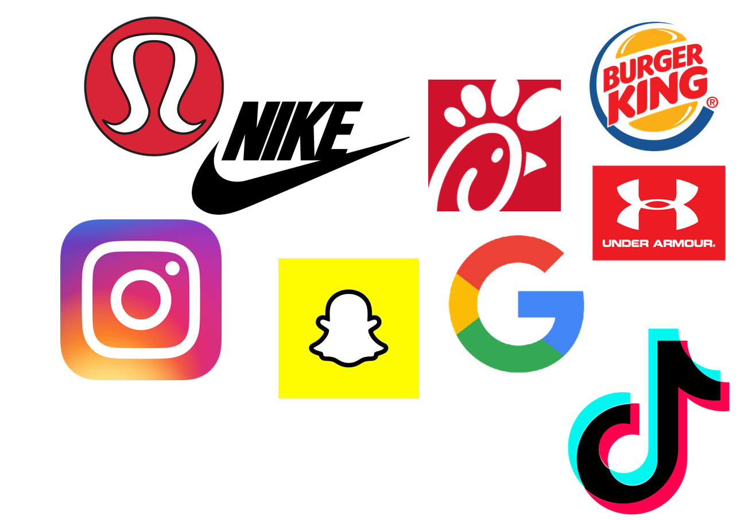
An Icon is an image that represents something.
like a logo for a product
or an app on your phone.

Slide 3
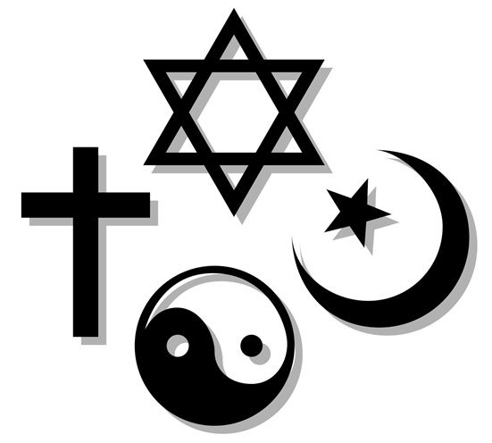
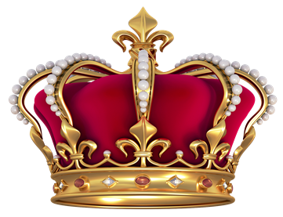
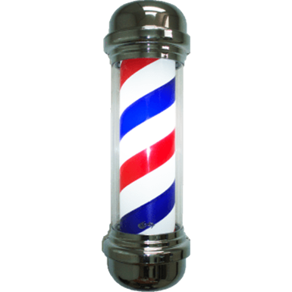
An Icon is an image that represents something.
Icons have been used for centuries to let people know…..
what you sell or what service you provide, how you worship, or what social status you hold

Slide 4
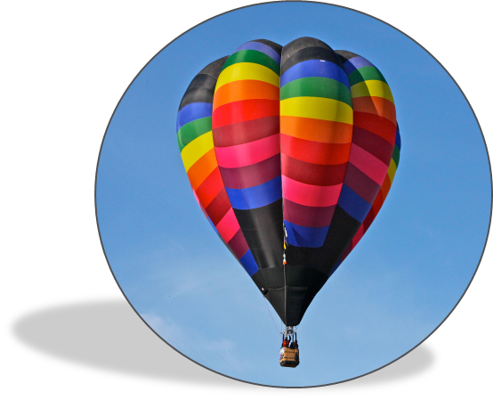
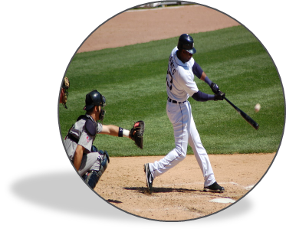
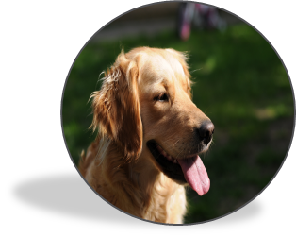
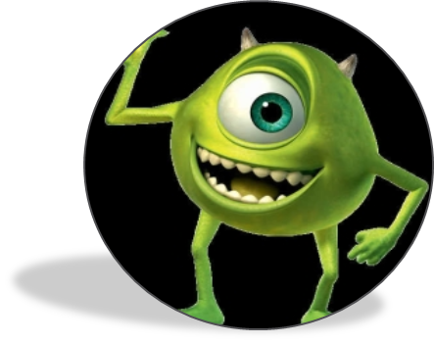
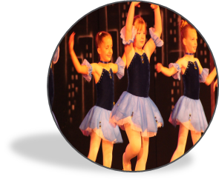
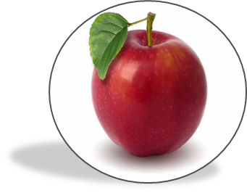
I have had a lot of fun looking at your icon images! The little circle photo next to your name in google classroom.
And I am fascinated at how the image you chose represents you.

Slide 5
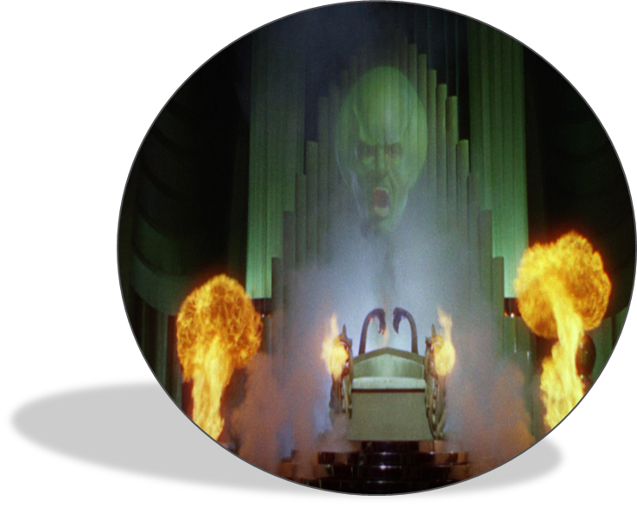
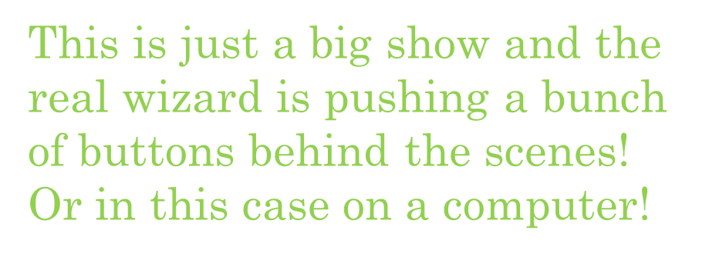
I spent a lot of time picking out an icon to represent me!
Here is what I came up with:
Why do you think I chose this image?
Think like an artist.
Who or what is this an image of ?
How does it represent the way I am teaching
you during this time?

Slide 6
Last week I asked you to:
look at your Icon that you chose for your google account.
Tell me in the questionnaire what your image is, and how it represents you.

Slide 7
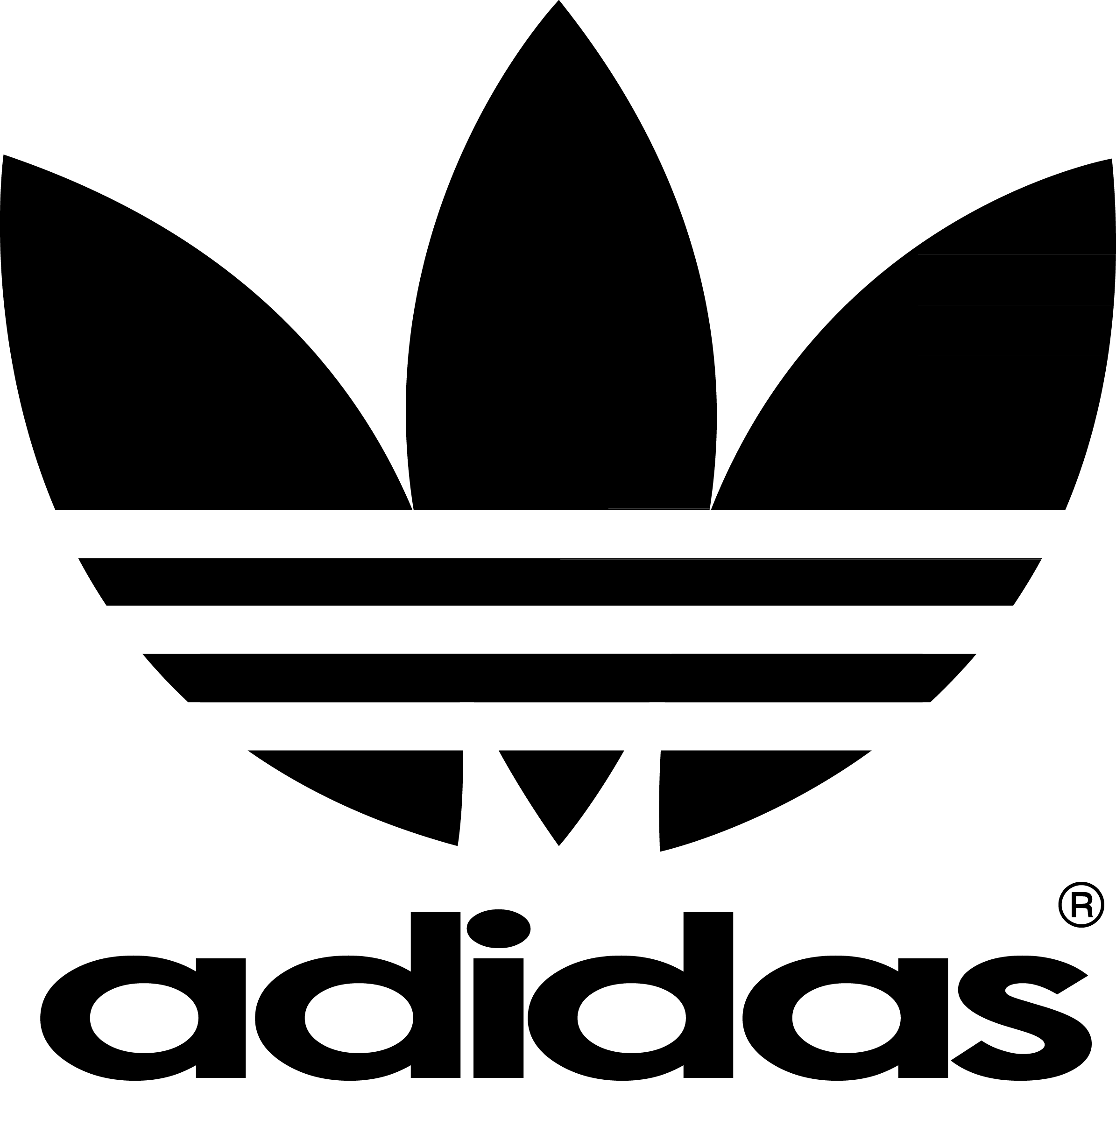
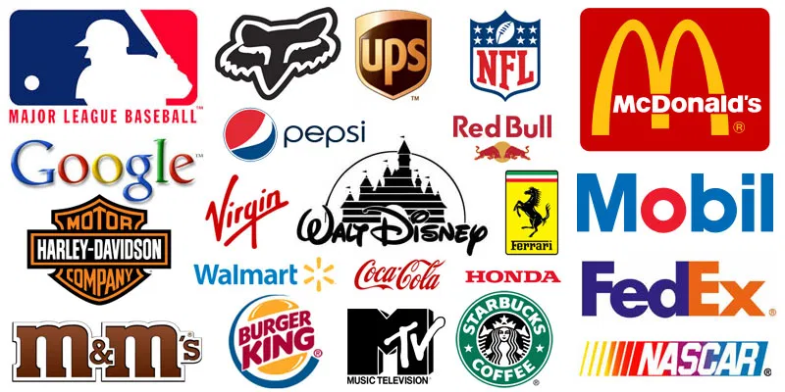
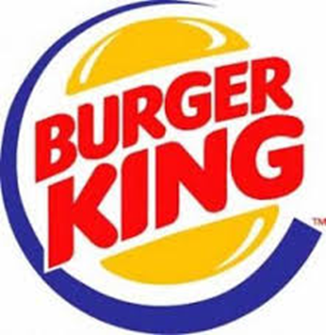
This week we will be looking at LOGOs.

Slide 8
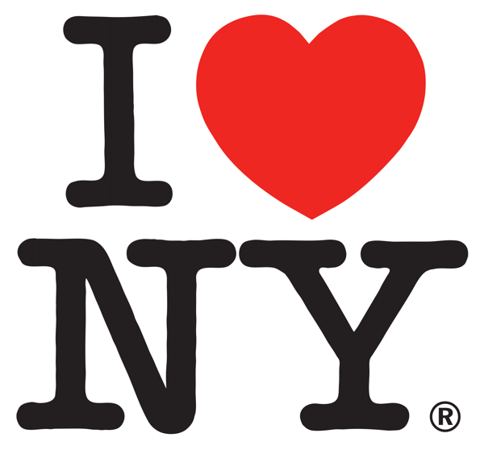
What is a Logo?
A logo is a sign, symbol, or trademark that conveys the identity of a product, company, campaign or concept in as memorable a way as possible.
How are logos used?
A logo can be used in many different forms, sizes and places.
For example, the logo for a hotel could be printed on a letterhead or menu, sewn onto a napkin or jacket, embossed on pens or illuminated as a huge neon sign on the side of the building.
What are the basic qualities of a good logo?
A logo should be simple so that the design is clear in different contexts. Also, a simple logo design is faster to read, easier to remember and more instantly identifiable.
The 'I Love New York' logo by Milton Glaser, one of the most reproduced logos ever, illustrates most of these basic qualities.
What is the main function of a logo?
A logo should convey an immediate and memorable identity and must connect with its target audience in a positive manner.

Slide 9
Look at ICONs and LOGOs that you see all the time.
What does the icon or logo tell us about the product or the app?
Think like an artist!
What do you see when we look at the Burger King logo?
First of all, it is a SIMPLE design. The name/words are an image of a hamburger and the yellow-orange shapes on the top and bottom are the bun. The blue swoosh around it indicates fast movement.
What does the logo tell us about the product?
This tells us that they sell hamburgers, and they serve them quickly.
We can use the same questions to analyze any logo or image this way!

Slide 10
Design your own logo
to represent you!
Create a logo design that represents you as a person.
Your logo must represent/symbolize your personal interests and beliefs.
We will look at the main types of logos on the next few slides

Slide 11
The main logo types:
Monogram logos (or lettermarks)
Monogram logos or lettermarks are logos that consist of letters, usually initials.
Monograms can be much easier to remember rather than a long name.
Think of NASA versus the National Aeronautics and Space Administration?

Slide 12
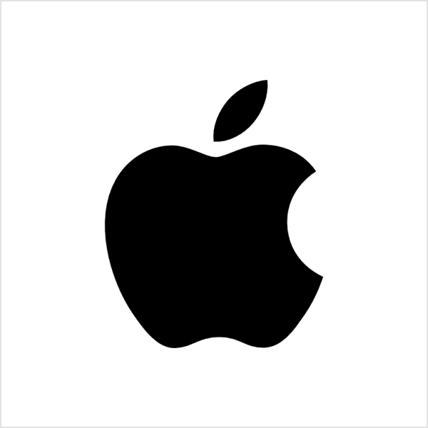
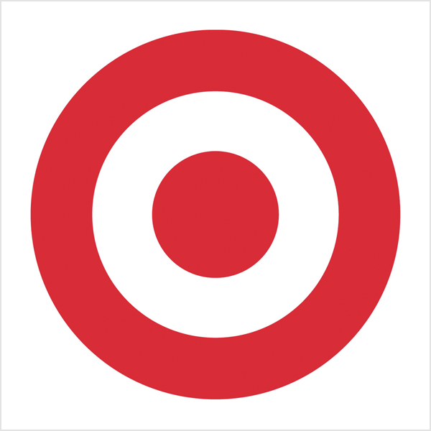
The main logo types:
Pictorial marks (or logo symbols)
A pictorial mark (or logo symbol) is an icon—or graphic-based logo. It’s probably the image that comes to mind when you think “logo”: the iconic Apple logo, the Twitter bird, the Target bullseye. Each of these companies’ logos is so emblematic, and each brand so established, that the mark alone is instantly recognizable. A true brand mark is only an image.

Slide 13
The main logo types:
Mascots
Mascot logos are logos that involve an illustrated character. Often colorful, sometimes cartoonish, and most always fun, the mascot logo is a great way to create your very own spokesperson—er, spokes-character(?).
A mascot is simply an illustrated character that represents you. Famous mascots include the Kool-Aid Man, KFC’s Colonel and Planter’s Mr. Peanut.

Slide 14
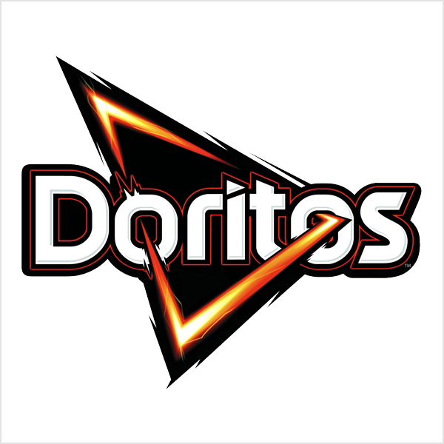
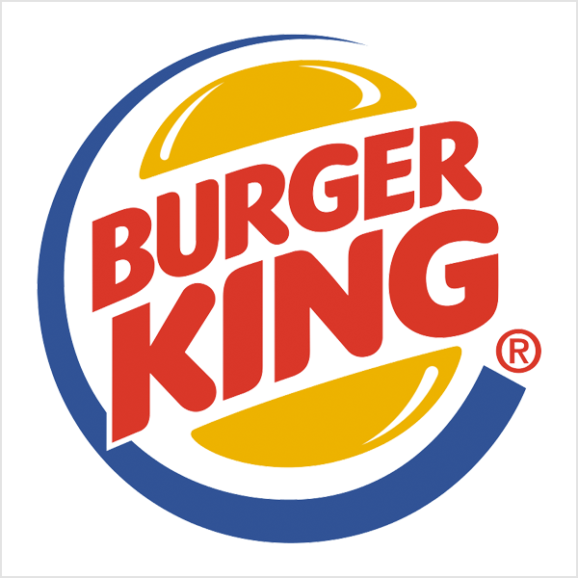
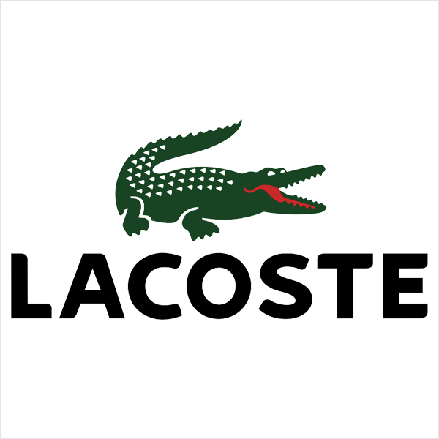
The main logo types:
The combination mark
A combination mark is a logo comprised of a combined wordmark or lettermark and a pictorial mark, abstract mark, or mascot. The picture and text can be laid out side-by-side, stacked on top of each other, or integrated together to create an image. Some well known combination mark logos include Doritos, Burger King and Lacoste.

Slide 15
Design your own logo to represent you.
Create a logo design that represents you as a person.
Your logo must represent/symbolize your personal interests and beliefs.
You can choose to use a:
-Monogram
-Pictorial mark
-Mascot
-Combination
Note: The first ideas that you think of are not usually the most original. The reason they are already in your head is because you have seen them before in one form or another. The best ideas are those that you discover by trial and error through composing the components of your design to create a concept.

Slide 16
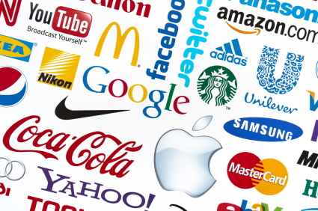
Design your own logo to represent you.
-Create a logo design that represents you as a person.
-Be creative
-Draw your logo on unlined paper
-Photograph it and submit it on google classroom

